Slide 1

Enhancing AI Literacy Through Interactive Fruit Ripeness Classification: A Machine Learning Game for K-12 Education
Sarbagya Malla

Slide 2


Agenda
Abstract
Introduction and Motivation
Related Work
Design
Technical Implementation
Research Questions, Data Collection, and Learning Activities

Slide 3
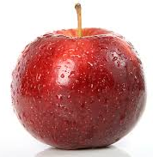
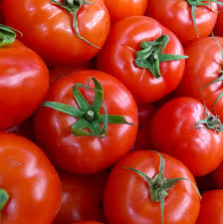
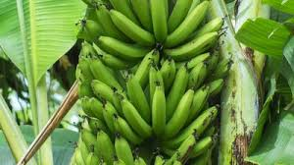
Abstract
This project introduces an interactive fruit ripeness game using machine learning to enhance AI literacy in K-12 education through hands-on supervised learning experiences with a few XAI features

Slide 4
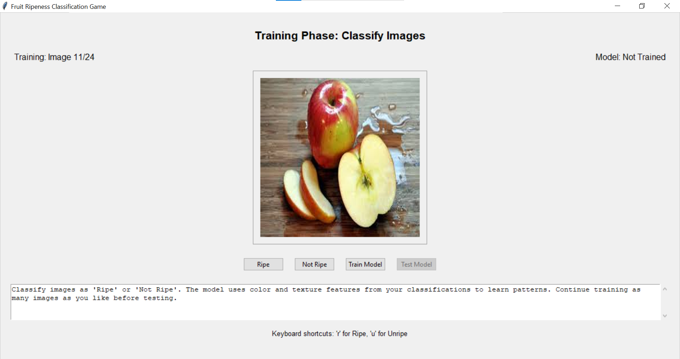
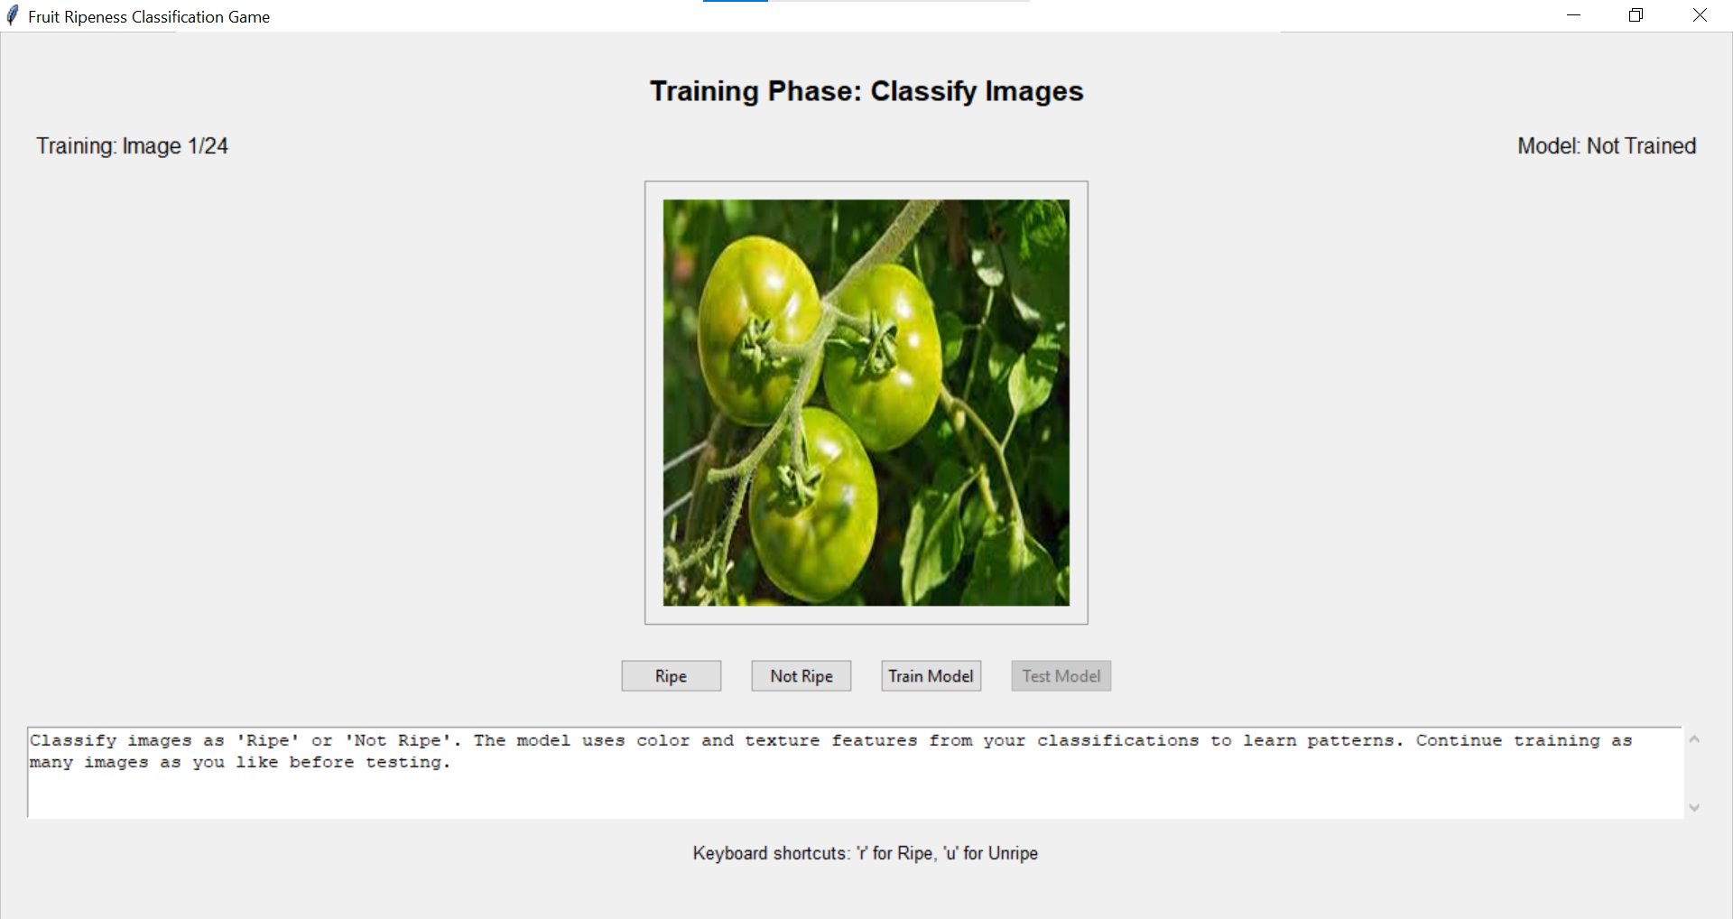
Introduction and Motivation
By allowing students to train a model and observe its predictions, the project enhances their understanding of AI, classification algorithms, and data-driven decision-making.

Slide 5
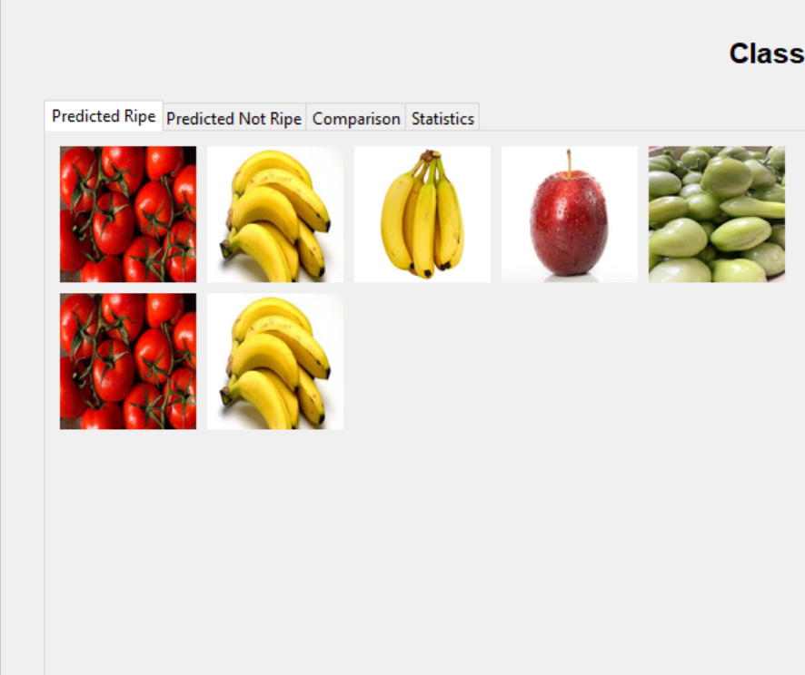
Related Works
Chen et al. (2020) "Artificial Intelligence in Education: A Review."
Latif et al. (2023) "Machine Learning in Higher Education: Students' Performance Assessment Considering Online Activity Logs."
Pesek et al. (2022) "The Role of AI in the Education and for the Education."
Mon et al. (2023) "A Study on Role of Artificial Intelligence in Education."
Wu (2020) "Machine Learning in Education."
Jotsov et al. (2022) "Using Machine Learning Algorithms to Improve Education Process."

Slide 6
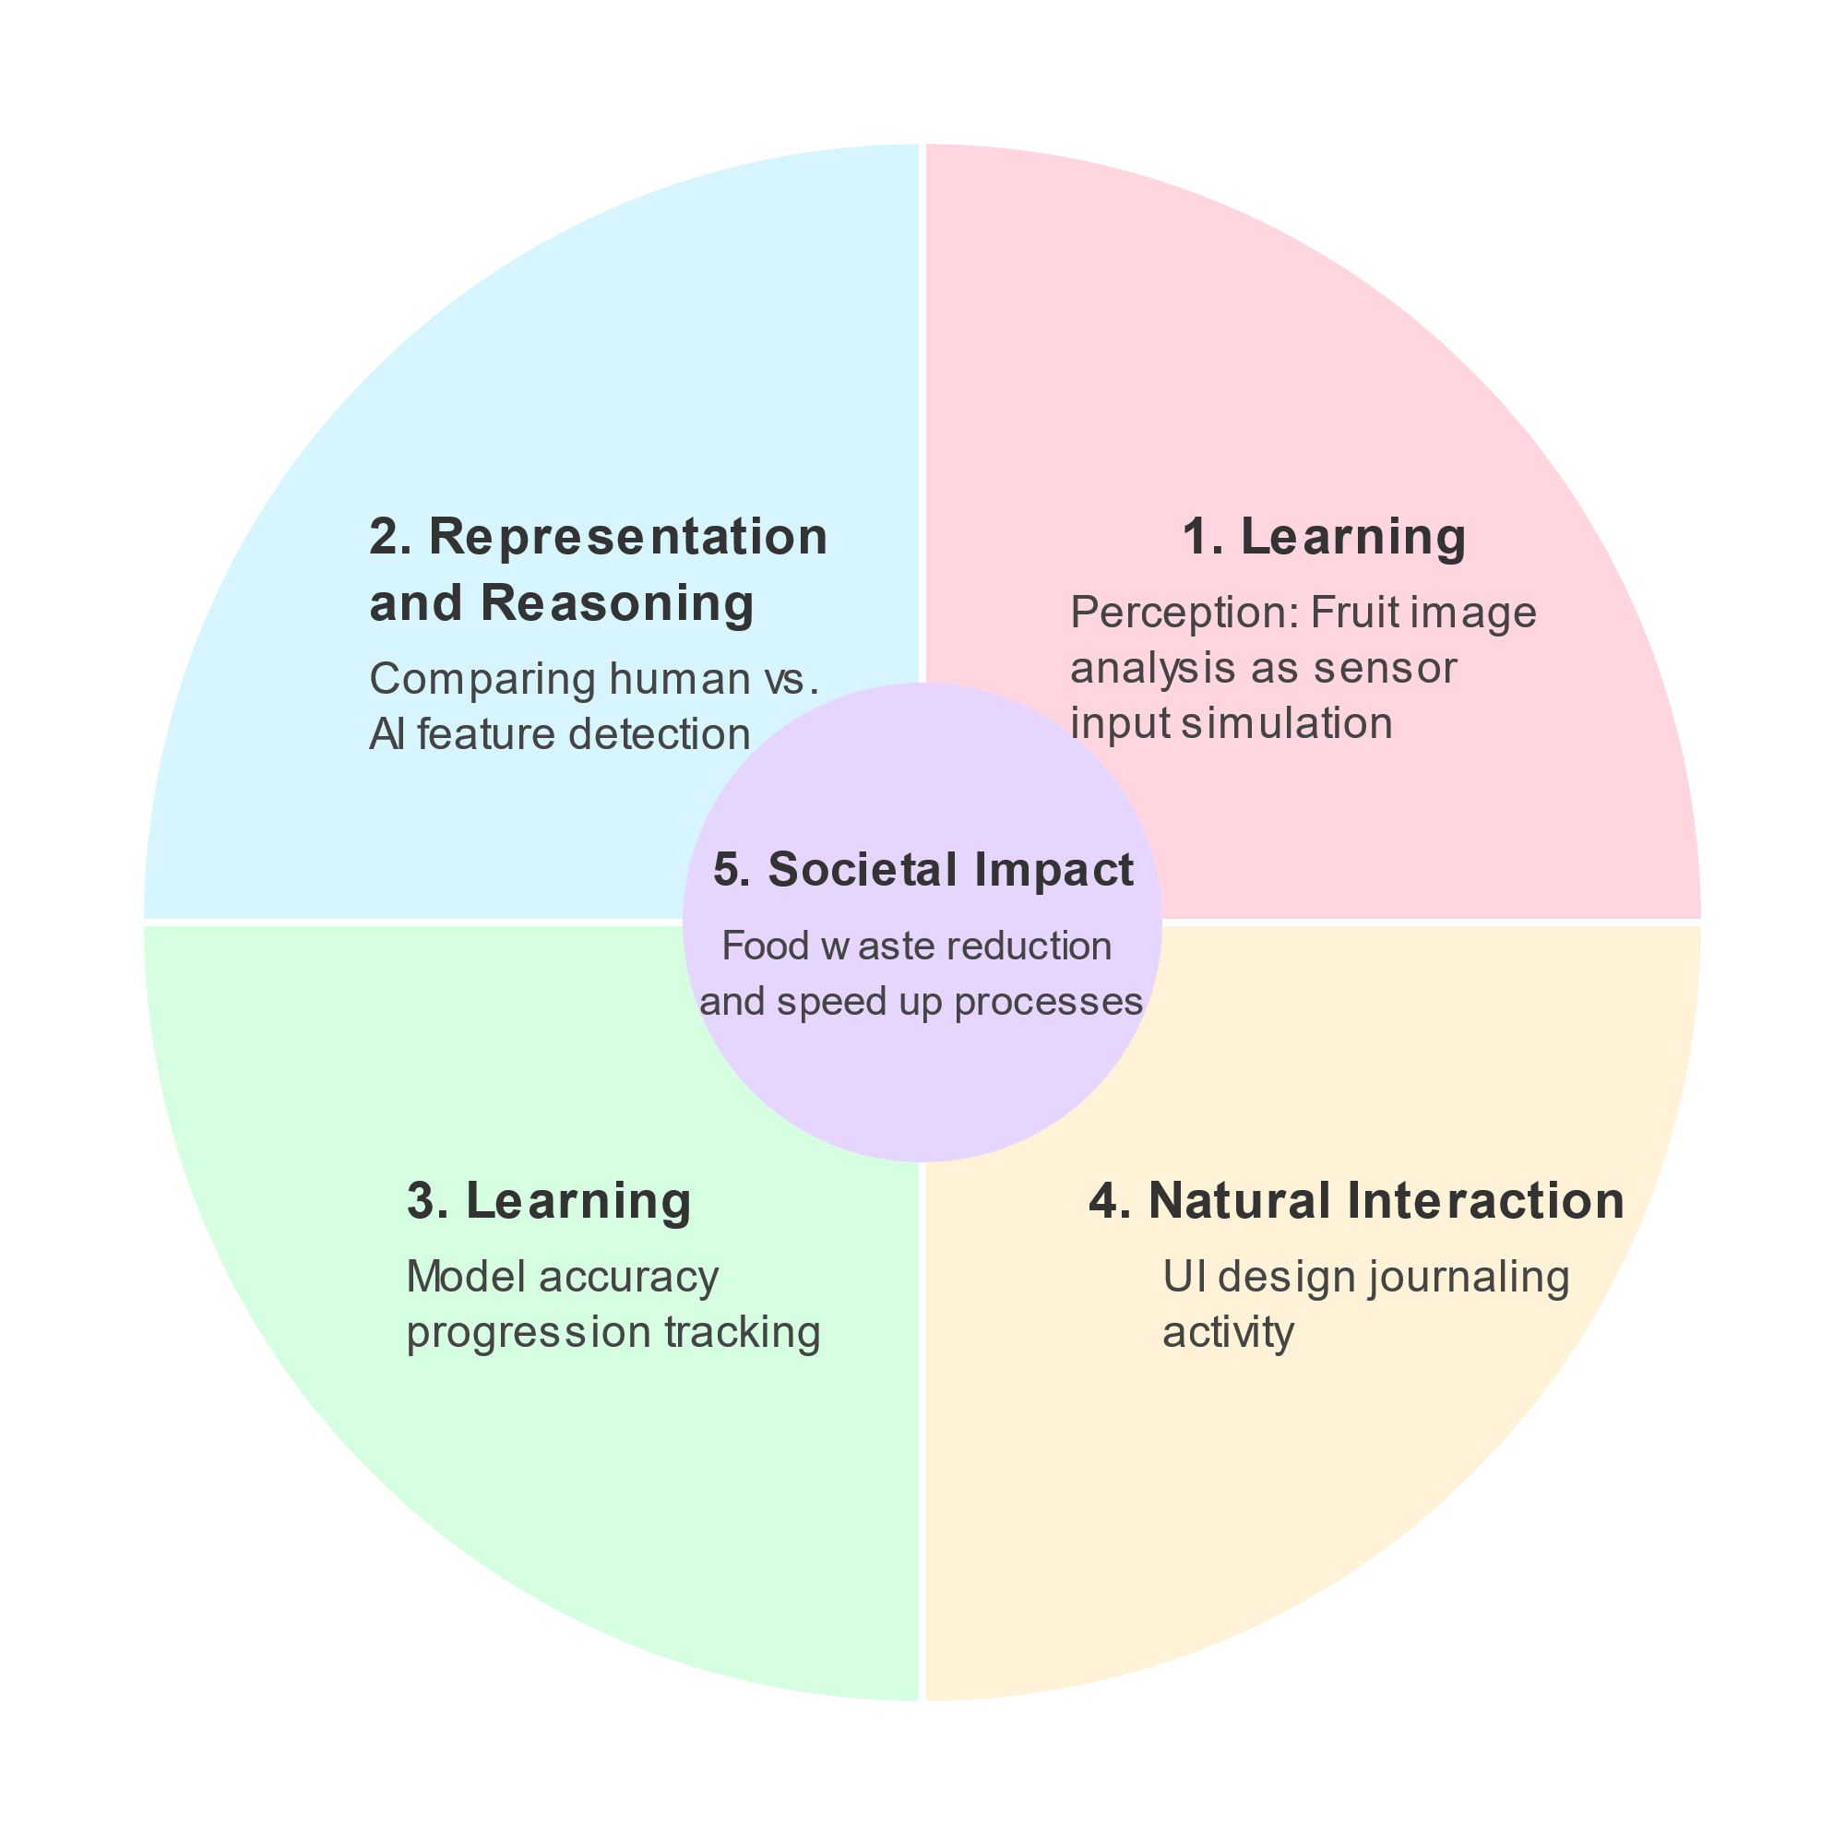
Design
A training interface for uploading labeled fruit images
A testing interface for classifying new images
A results section displaying model predictions with visual feedback
Graphical representations of classification accuracy using pie and bar charts
Explainable AI Features

Slide 7
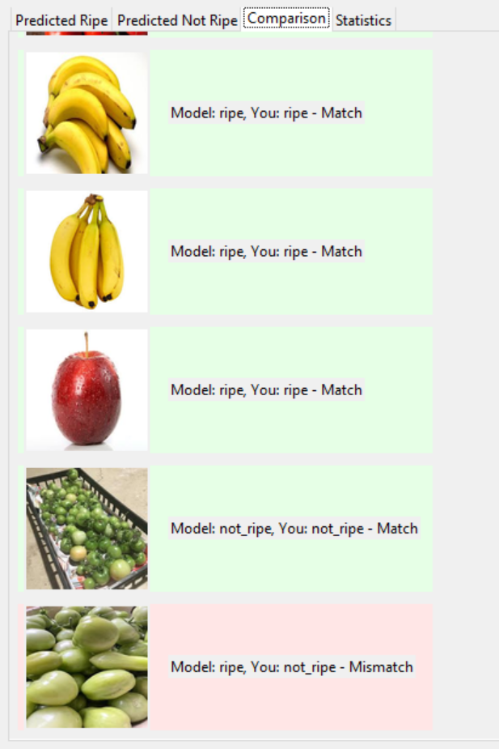
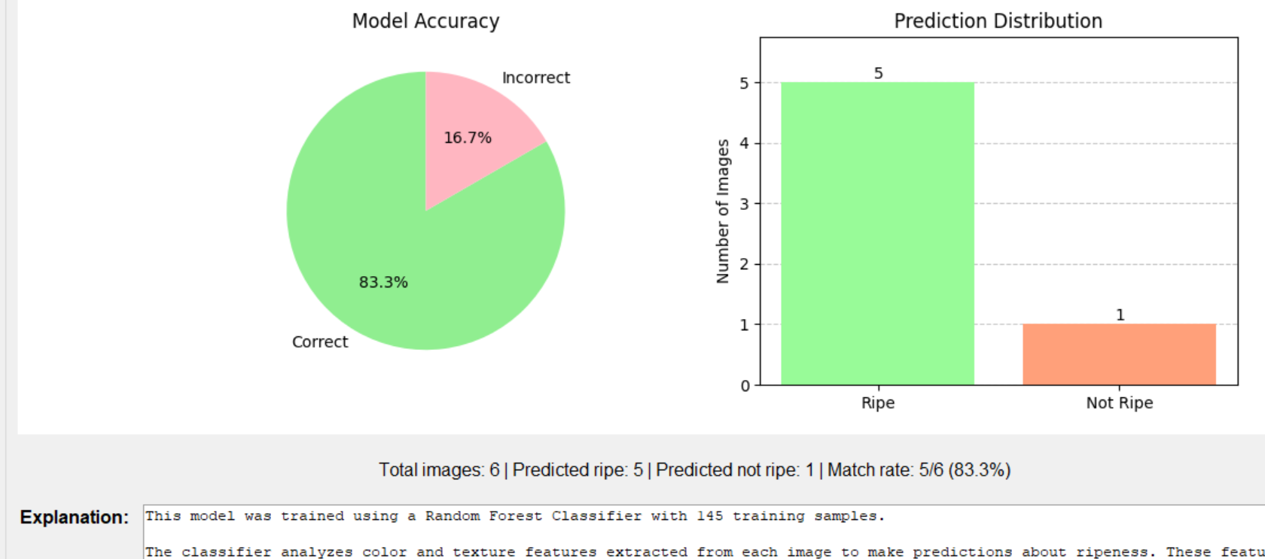
Technical Implementations
Image feature extraction using OpenCV
Tkinter for GUI development
Matplotlib for data visualization
A dataset of fruit images labeled as "ripe" and "not ripe“
Explainable AI Techniques

Slide 8


Research Questions
Research Questions-
How does the interactive fruit ripeness classification game enhance students' understanding of machine learning and classification algorithms?
What is the impact of providing real-time feedback on students' learning about supervised learning techniques?
How do students perceive the transparency of AI decisions when Explainable AI (XAI) techniques are incorporated into the game?
Does the game's interactive nature increase student engagement in learning about AI and machine learning?

Slide 9


Data Collection Methods and Learning Activities
Data Collection Methods
Pre-survey to aassess students' prior knowledge of AI
Post-survey to evaluate learning outcomes and engagement levels
Learning Activities
Model training using a dataset of fruit images
Model testing and prediction accuracy analysis
Discussions on AI bias and dataset selection

Slide 10


Thank you
Presenter name
Email address
Website

